Slide 1
Acts 4v1-22
A New Boldness

Slide 2
Stealth at Thorpe Park

Slide 3
The Spirit turns Uncertainty into Confidence

Slide 4
¹¹ Jesus is ‘“the stone you builders rejected, which has become the cornerstone.” (quote from Ps118) ¹² Salvation is found in no one else, for there is no other name under heaven given to mankind by which we must be saved.’
Peter in Acts 4v11-12

Slide 5
I am the way the truth and the life, no one comes to the Father except through me.
Jesus in John 14:6

Slide 6
¹² Salvation is found in no one else, for there is no other name under heaven given to mankind by which we must be saved.’
Peter in Acts 4v12

Slide 8
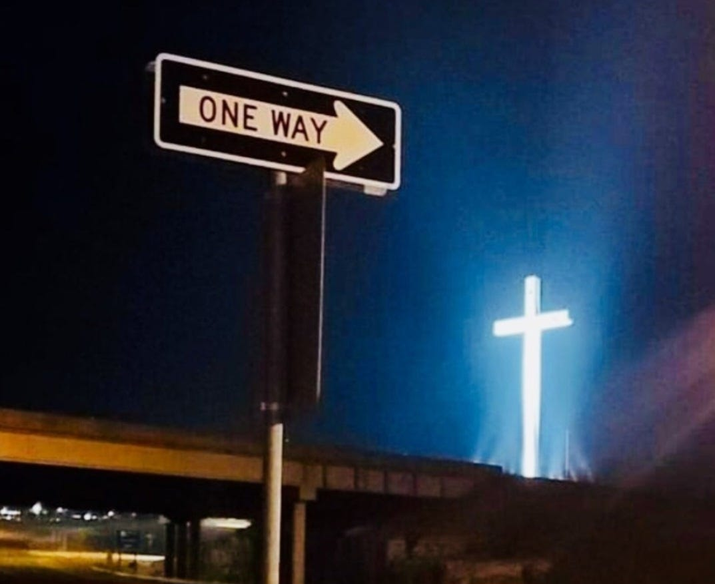

Slide 9
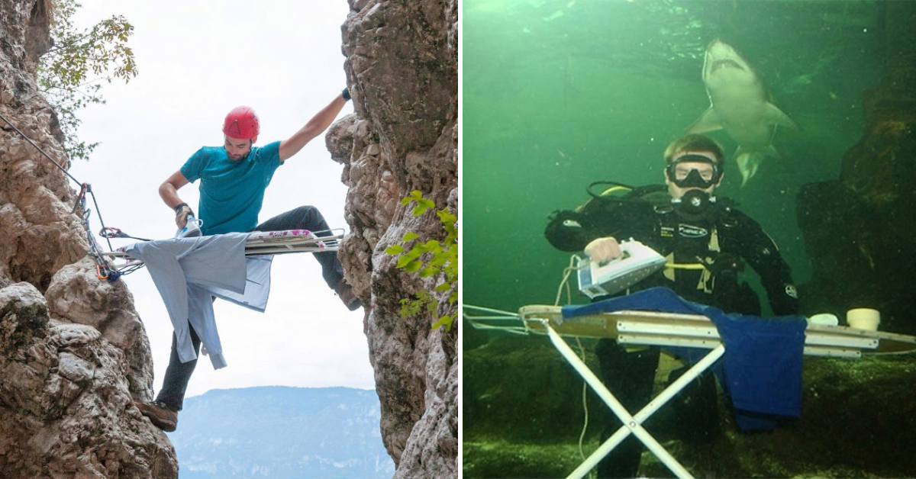
Extreme ironing!

Slide 10
σῴζω (sōzō)
v9 “this man stands before you healed”
(same word)
v12 “by which we must be saved”

Slide 11
The Spirit turns Uncertainty into Confidence

Slide 12
The Spirit turns Fear
into Courage

Slide 13
¹³ When they saw the courage of Peter and John and realised that they were unschooled, ordinary men, they were astonished, and they took note that these men had been with Jesus.
Acts 4v13

Slide 14
For God gave us a spirit
not of fear
but of power and love
and self-control.
2 Timothy 1v7

Slide 16
The Spirit turns Fear
into Courage

Slide 17
But when they arrest you, do not worry about what to say or how to say it. At that time you will be given what to say, for it will not be you speaking, but the Spirit of your Father speaking through you.
Jesus in Matthew 10 v19-20

Slide 18
The trouble with so many people is that the voice of their neighbours sounds louder in their ears
than the voice of God.
HG Wells

Slide 19
As for us,
we cannot help speaking
about what we have
seen and heard’
Peter in Acts 4v20

Slide 20
they took note that these men had been with Jesus.
Sanhedrin in Acts 4v13

Slide 21
The Spirit turns Uncertainty into Confidence &
Fear into Courage
So let’s seek Him!

